Slide 1
Career in Teaching Department Intern-Mentor Staff Development
Annamaria.Manso@RCSDK12.org

Slide 2
Professional Learning Opportunities
Career in Teaching Website
Left side – CIT Staff Development
CIT Professional Learning Catalog
Register at www.rcsdk12.truenorthlogic.com
ALL SESSIONS TO TAKE PLACE AT THE RTA OFFICES
30 North Union Street

Slide 3
Other Professional Learning Opportunities
Rochester Teaching Academy
Rochester Teacher Center
Roc Restorative

Slide 4
Domain 4 –Professional Responsibilities
4e: Growing and Developing Professionally
As in other professions, the complexity of teaching requires continued growth and development, in order to remain current.
Indicators include:
Frequent teacher attendance in courses and workshops; regular academic reading.
Participation in learning networks with colleagues; feedback freely shared
Participation in professional organizations supporting academic inquiry.

Slide 5
Offerings
Classroom Management Q & A (10/9 – 4:15-6:15)
Preparing for your Parent-Teacher Conferences(10/1 – 4:15-6:15)
Writing Progress Reports, Preparing for Annual Reviews, and Writing Quality Goals (9/18, 9/25, 10/2 – 4:15-6:15)
Co-Teaching; A Shared Belief System for Success in Teaching and Learning in the Special Education Classroom
Learn How To Use The Danielson Framework To Enhance Your Practice
(12/2 and 12/9 – 4:15-6:15)

Slide 6
Bilingual
Best Practices for Working with ELLS: Incorporating Translanguaging Strategies into Instruction
Best Practices for Working with ELLS: Understanding the Bilingual Common Core Progressions
Best Practices for Working with ELLS: Understanding the Bilingual Common Core Progressions
Best Practices for Working with ELLS: Using SIOP to Guide Planning and Instruction
Co-Teaching; A Shared Belief System for Success in Teaching and Learning in the Bilingual Classroom

Slide 7
Culturally Responsive Teaching and The Brain
Trauma and Resilience: What is a Trauma Informed School ?
Using Restorative Language in the Classroom
Integrating Peace Circles in the Classroom
Integrating Academic Circles in the Classroom
Self-Care for Teachers

Slide 8
Establishing Collaborative Classrooms Elementary (K-6)
Activities to implement and develop collaborative relationships within the classroom environment.
Using interactive modeling to reflect, develop and implement rituals and routines.
Reflect on teacher and student roles in developing collaborative classrooms through restorative practices, engagement, academic and behavioral protocols.

Slide 9
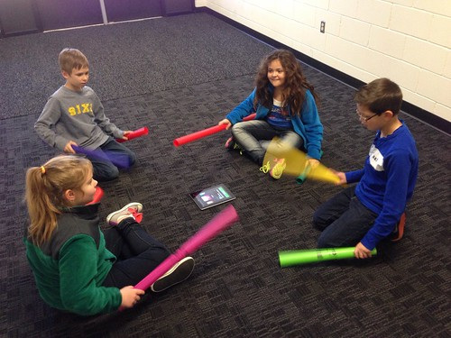




Secondary (7-12)
3 As
Creating a Positive Environment for Students
Creating an Environment of Respect and Rapport
Establishing a Culture for Learning

Slide 10
PROACTIVE CLASSROOM SYSTEMS
Building Positive Relationships
Defining and Teaching Expectations
Creating Systems for Acknowledgment and Correction
(5:1)
Establishing Rituals and Routines
Engaging Students
Matching the Environment
Utilizing for Assessment
Effective Instruction
Notes:
Here is the overview of the Proactive Classroom Systems course.

Slide 11
In Closing…
We are here to meet your needs! If there is something that you would like to see offered, talk to your mentor, or email me directly!
Annamaria.Manso@RCSDK12.org

